Slide 1
Project Assignment #1
Prepared by: Batch 6 Group 28

Slide 2
Table of Contents
Yellevate
Objectives
01
02
Findings
Recommendation
03
04
Who is Yellevate?
A brief discussion of objectives and goals
Analysis made from the processed data
Suggestions based on the analysis made

Slide 3
Who is Yellevate?
American marketing company providing services to other companies in and out the US with a distinct number 1,000 clients
China
Spain
Russia
France
United States
Notes:
Services: email marketing, website development, content creation, and others

Slide 4
Problem
The company's top management found out that the company has been experiencing customer issues costing millions of dollars.
Nearly 20% of the disputes raised resulted in a payment opt-out
Approximate 5% annual loss of revenue (in USD)
Notes:
The company's top management found out that the company has been experiencing customer issues costing millions of dollars. Customers files disputes which result in them not paying the company. Approximately, 20% of all transactions equates to a 5% annual revenue loss.

Slide 5
Objectives
Identify the root cause of customer’s disputes
Find out the cause of revenue loss
Give concrete strategies to mitigate those disputes
01
02
03

Slide 6
Goals
The processing time in which invoices are settled
The processing time for the company to settle disputes
Percentage of disputes received by the company that were lost
Percentage of revenue lost from disputes
The country where the company reached the highest losses from lost disputes

Slide 7
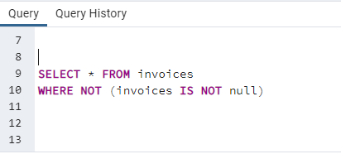
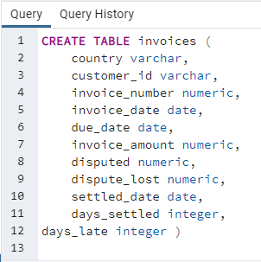
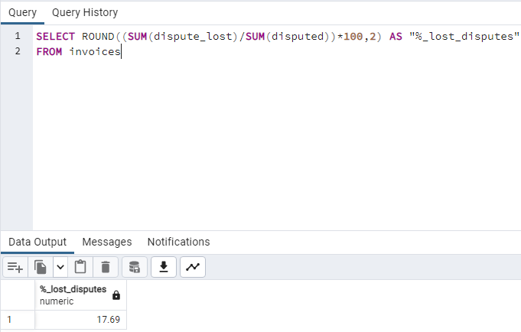
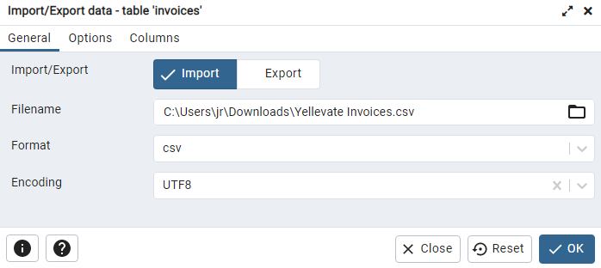
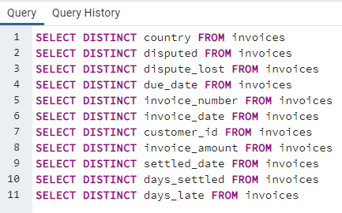
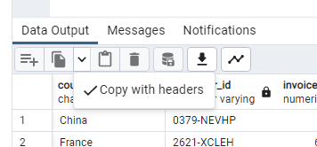
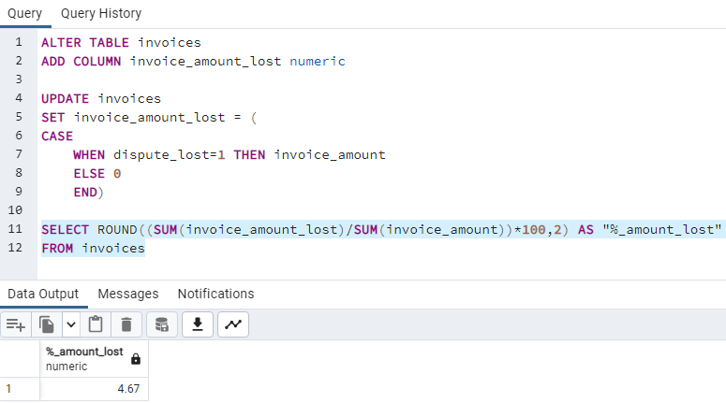
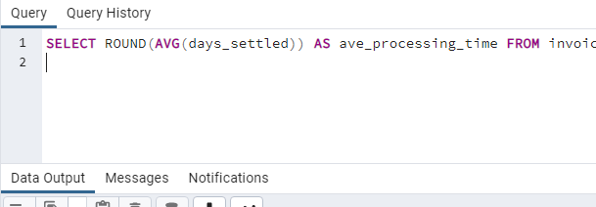
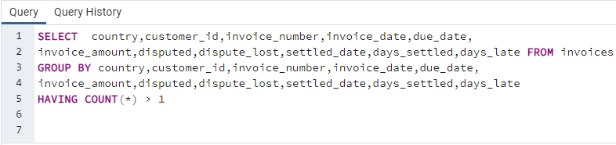
Methodologies
SQL Statements

Slide 8
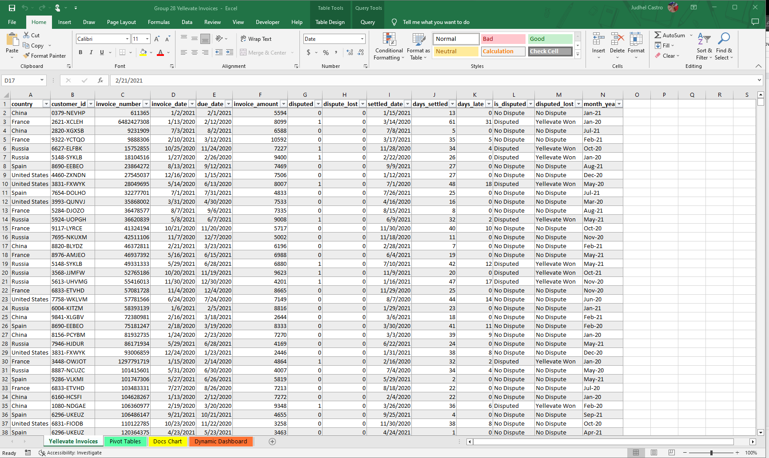
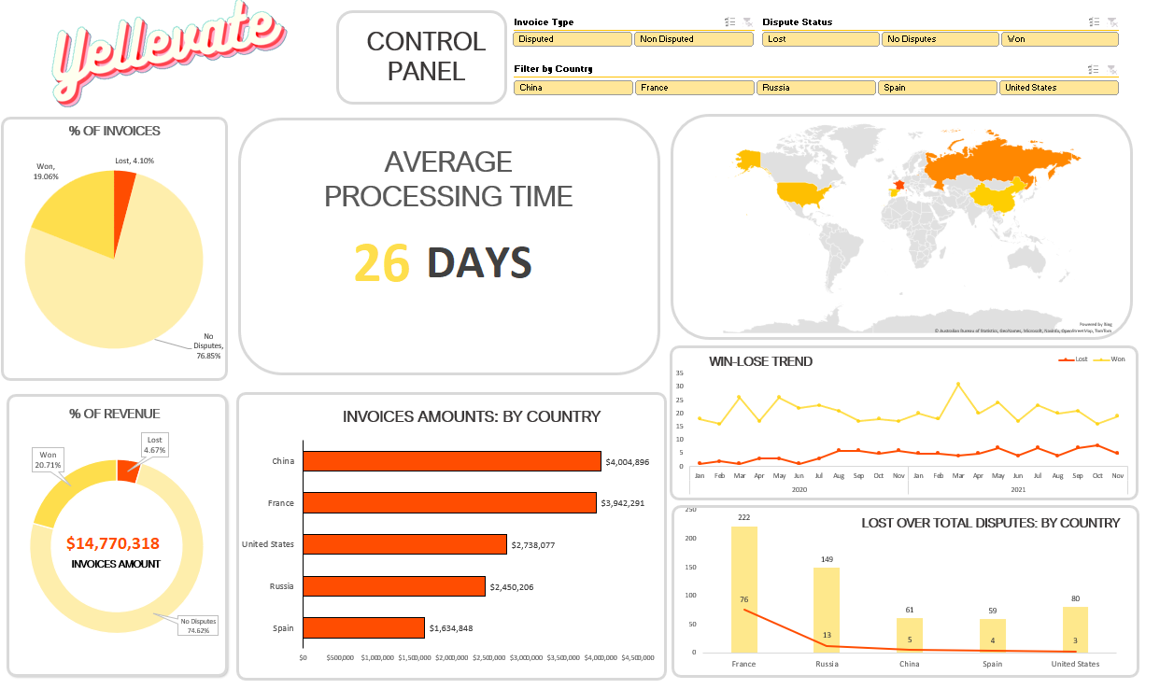
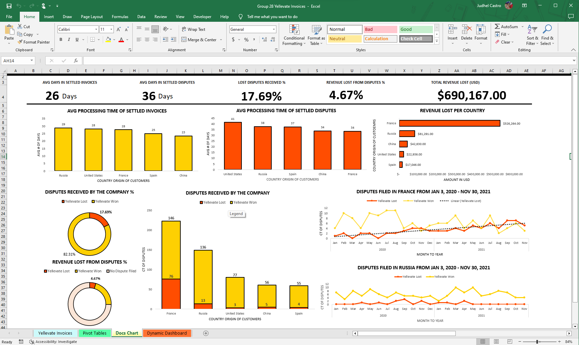
Charts from Pivot Tables
Invoices Clean Dataset
Dynamic Dashboard

Slide 9
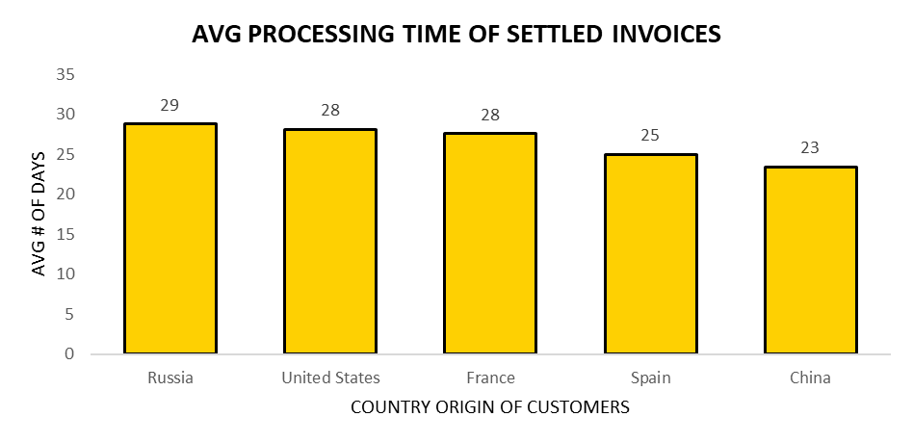
The average processing time for the clients to settle invoices is 26 days.

Slide 10
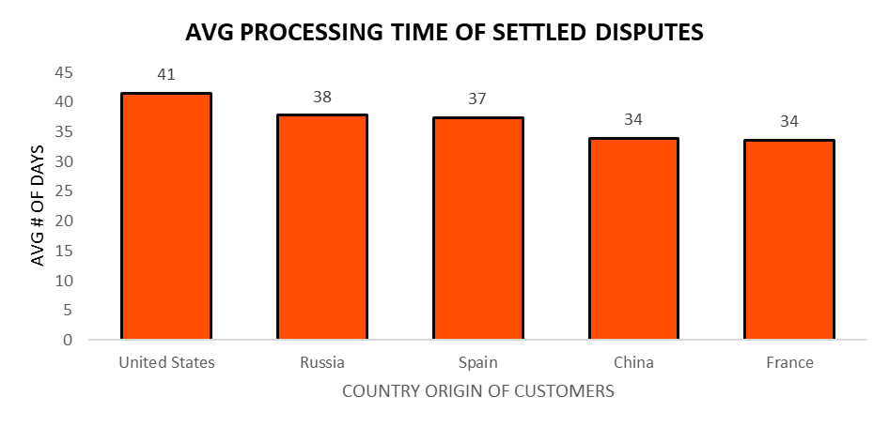
The average processing time to settle disputes is 36 days.

Slide 11
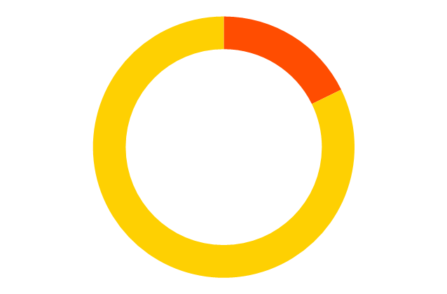
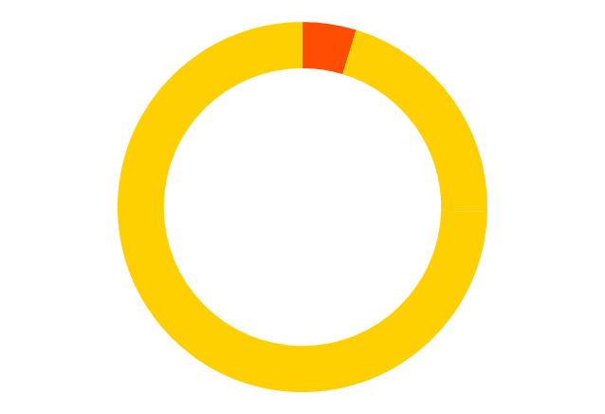
Yellevate’s Disputes
17.69%
4.67%
Lost by the company out of the received disputes
Revenue loss from Lost Disputes

Slide 12
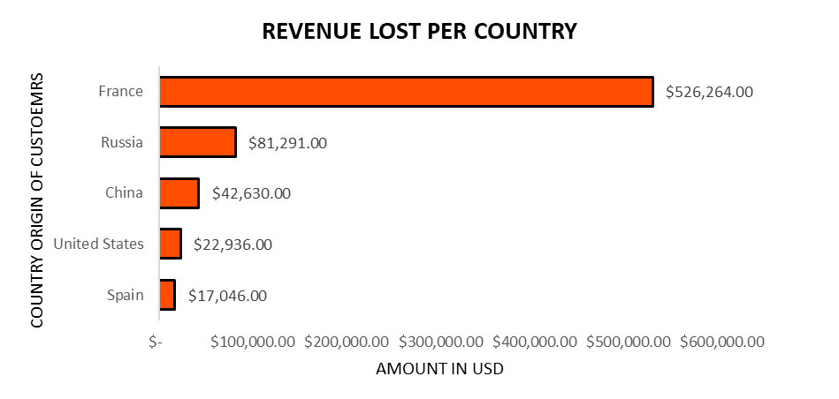
The company reached the highest loss in revenue for the dispute lost in France.

Slide 13
$690,167
Total Revenue Loss
(Jan 3, 2020 - Nov 30, 2021)

Slide 14
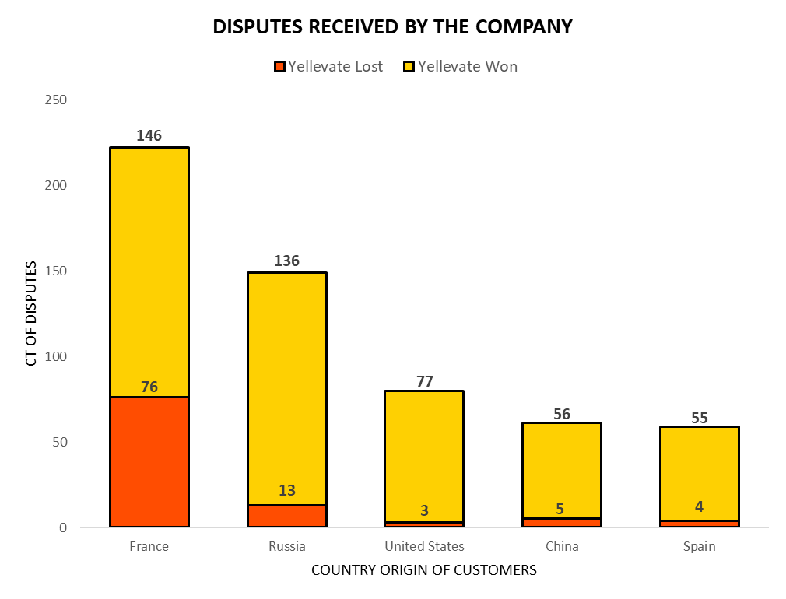
The highest contributors in in disputes filed which causes revenue loss is France and Russia

Slide 15
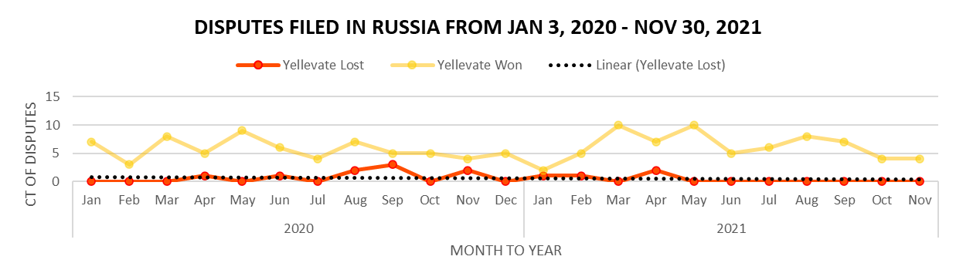
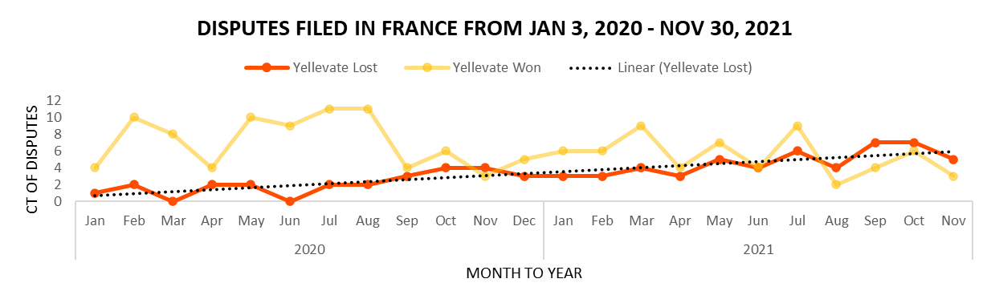
Russia keeps on filing for disputes even though they are just losing. It’s their way of expressing dissatisfaction.
Disputes in France where Yellevate lost is increasing overtime.
Notes:
To further analyze the reason for revenue loss, our team added
Russia - customers keeps on filing even though they are just losing. They are losing because their reason to file for dispute isn’t justified/valid.
France - their reason for disputes is justified that’s why they are winning. However, it is concerning since it is increasing overtime which means it can cause more loss to the company.

Slide 16
Recommendations
Rounds of Revision
Contract Technicalities
Review Payment Terms
Monitoring
Additional monitoring for the transactions of all clients from France.
Another round of revision instead of the immediate filing of disputes if the clients did not accept or agree to the deliverable.
An option for 2-3 rounds of revision which in exchange, nullifies the client's right to file for a dispute.
The terms of reference must be reviewed and assessed by the technical team before the contract signing.
30% Partial Payment (non-refundable)
70% Payment once completed

Slide 17
Thank you!
Does anyone have any questions?
Please keep this slide for attribution

